Slide 1


A Historic and Contemporary Examination of
Goal-Free Evaluation
Brandon W. Youker
Evaluation Lab Director

Slide 2
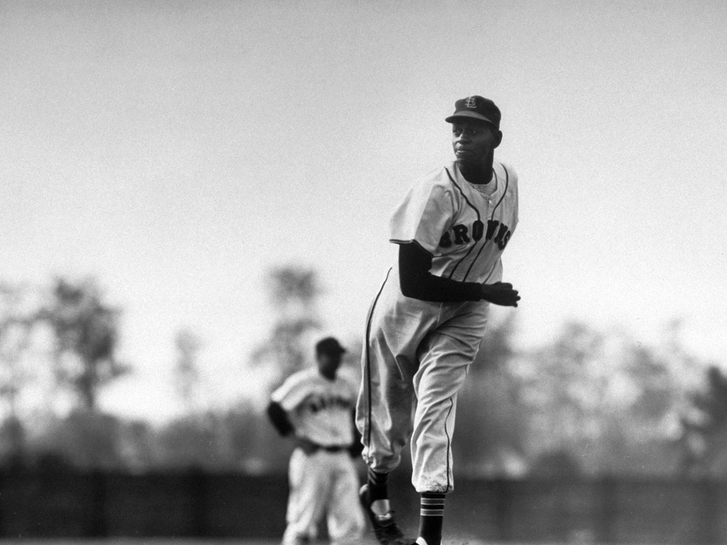
Goal-Free Evaluation
The Definition of GFE
Goal-free evaluation (GFE) is any evaluation in which the evaluator conducts the evaluation without referencing the evaluand’s predetermined goals and objectives.
“As you can learn from any baseball pitcher who has set out in the first inning to pitch a shutout, the game’s final score is the thing that counts, not good intentions.”
(Scriven, 1974, p. 58)

Slide 3
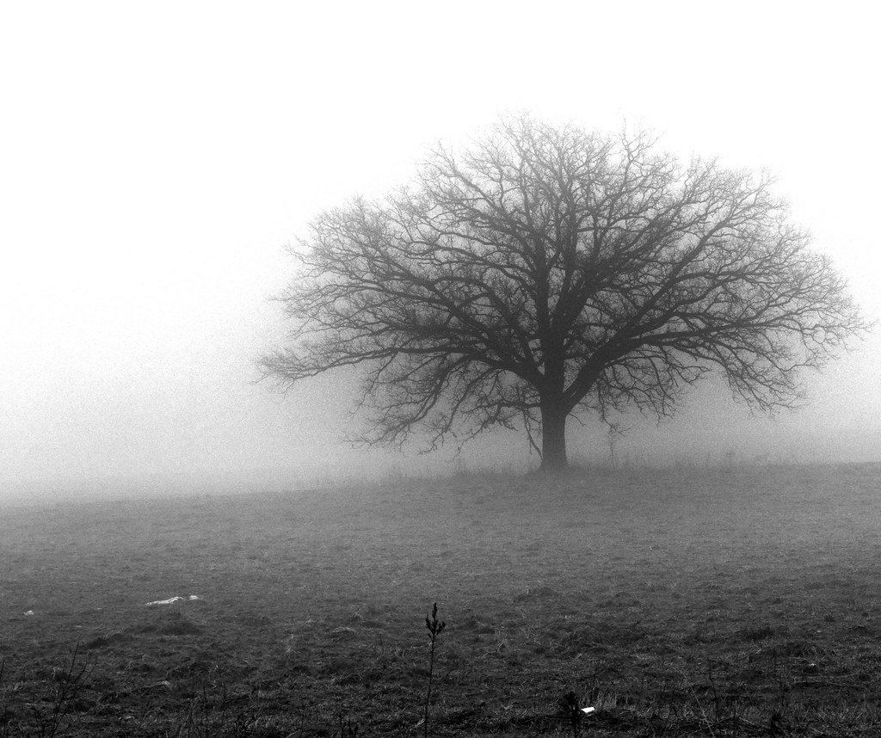
Goal-Free Evaluation
The Principles of GFE
The goal-free evaluator:
Identifies relevant effects to examine without referencing goals and objectives
Observes what occurred without being prompted by the goals and objectives
Determines if and to what degree the outcomes are attributable to the evaluand
Determines the degree to which the outcomes are positive, negative, or neutral
(Youker, 2013)

Slide 4
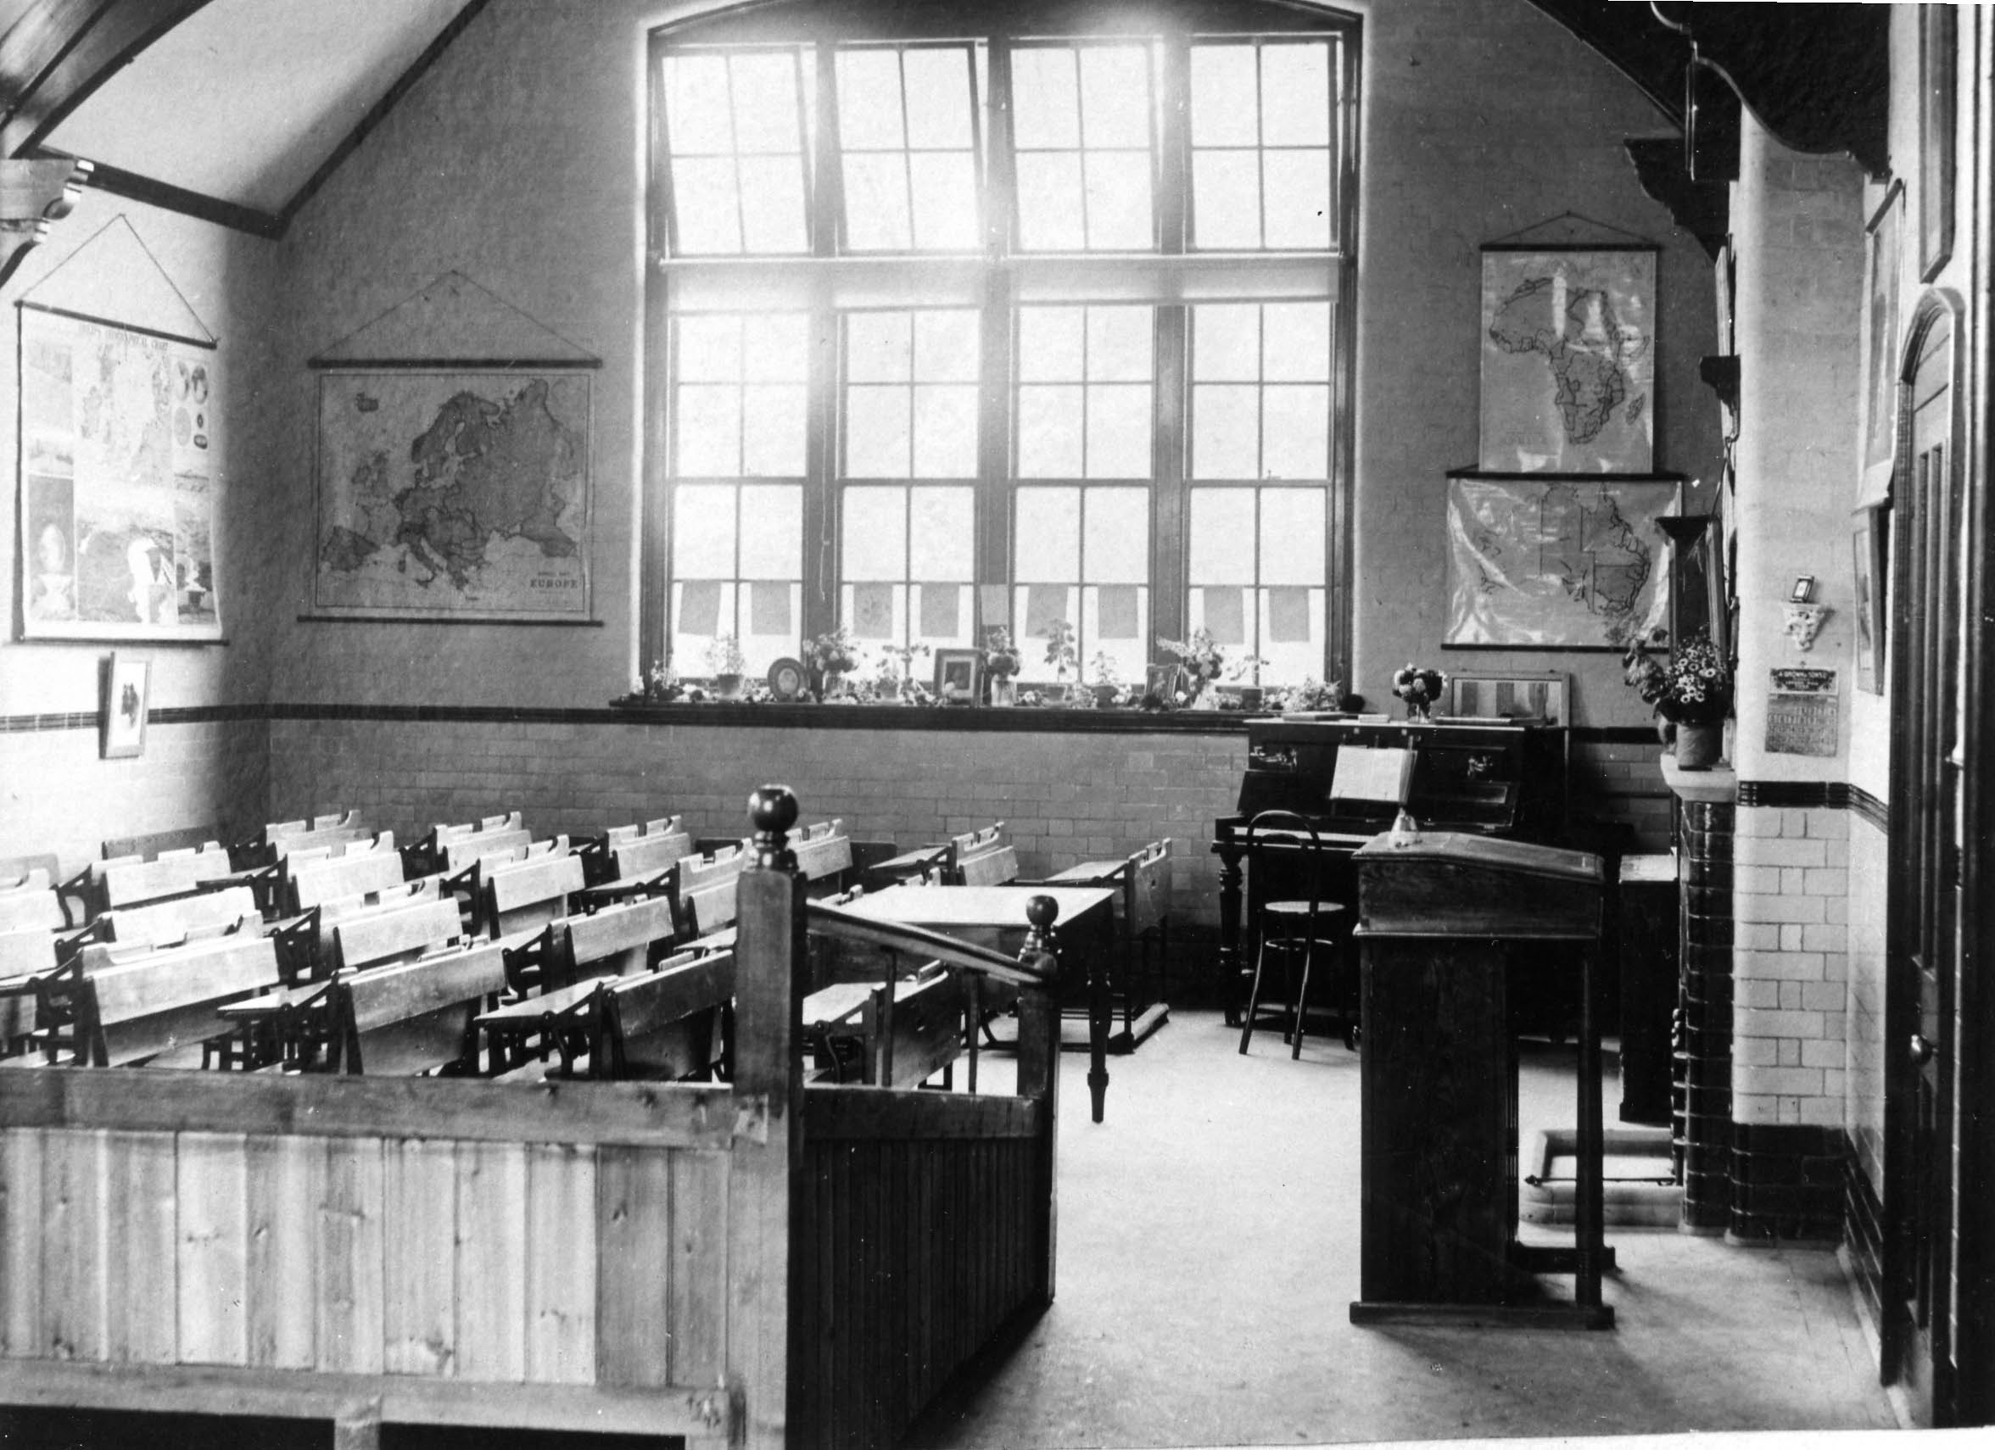
Episode 1: Goal-Based Evaluation
Introduction & Dominance of GBE
Ralph Tyler (1931, 1942) introduced GBE in evaluating secondary education in the 1930s and 1940s.
“As evaluation emerged as an independent field within the social sciences, it became closely identified with the measurement of goal attainment.”
(Friedman et al., 2006, p. 201)

Slide 5
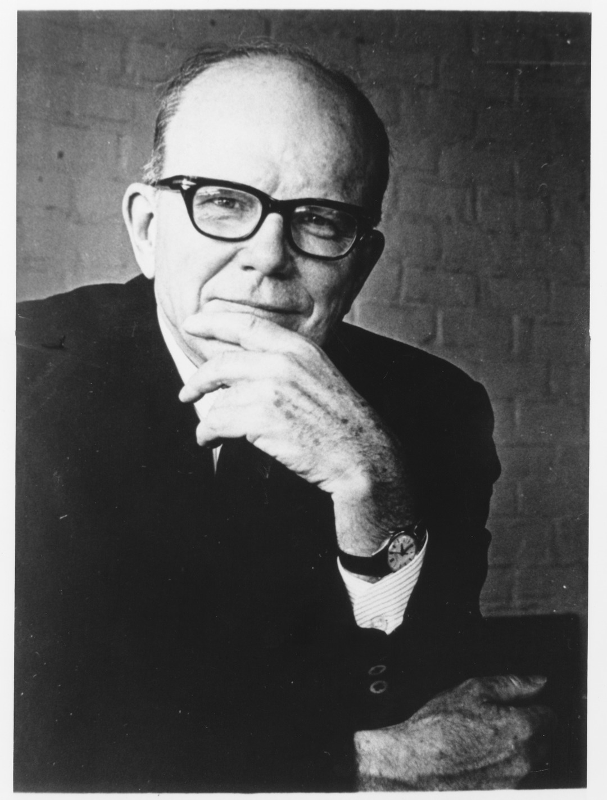
Episode 1: Goal-Based Evaluation
The Phases of GBE
Phases of Tylerian Evaluation
The evaluator:
Determines goals & objectives
Classifies the objectives by type
Refines the objectives & puts them into behavioral terms
Identifies situations when these behaviors may be observed
Tests & chooses different measures for gathering evidence
Pilot-tests instruments & collects performance data
Compares performance data & behavioral objectives
(Madus & Stufflebeam, 1989)

Slide 6
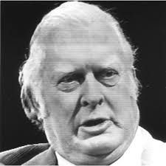
Episode 2: Goal-Free Evaluation
The Discovery of GFE
“Several evaluators have testified that Scriven’s suggestion in 1972 about the goal-free model was greeted by stunned disbelief. Completely ignoring objectives was shocking indeed. Scriven’s perseverance in making his point, however, seems to have had effects upon the theory and practice of American program evaluation.”
(Vedung, 2017, p. 59)

Slide 7
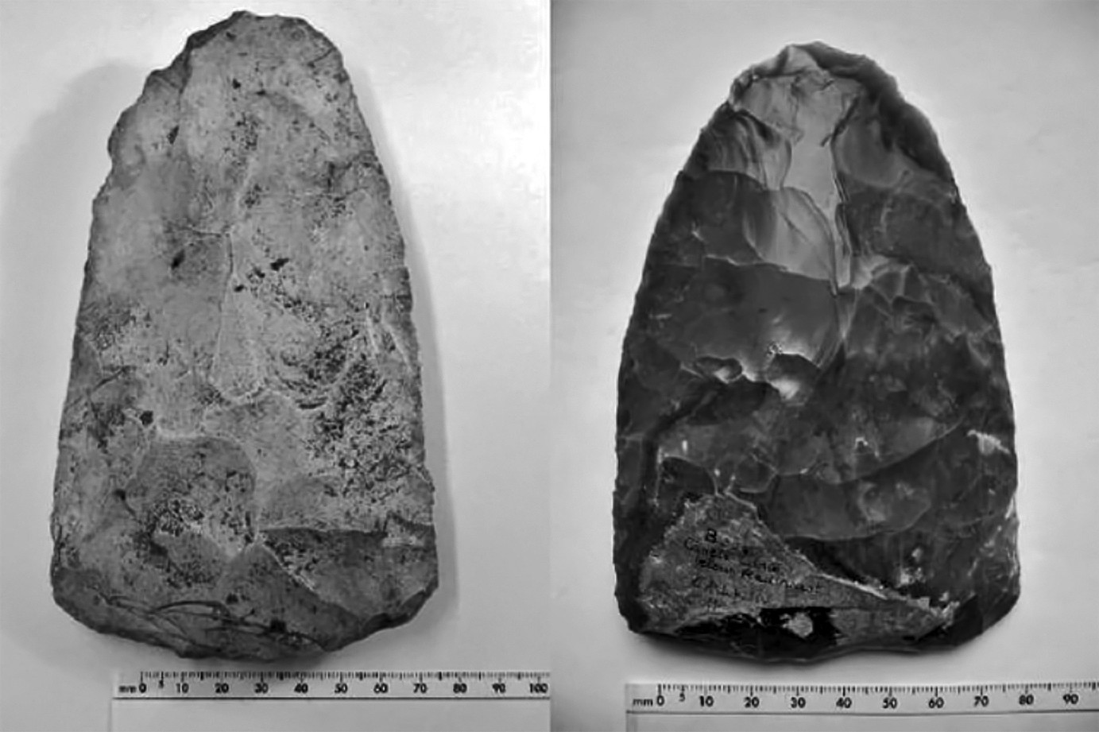
The Prequel:
GFE in Prehistory
Humanmade items, and building and agricultural techniques are spread throughout geographic regions and cultures. People traded.
When trading without a common language, the recipient determines merit without the knowledge of the maker’s specific (articulated) intentions.

Slide 8
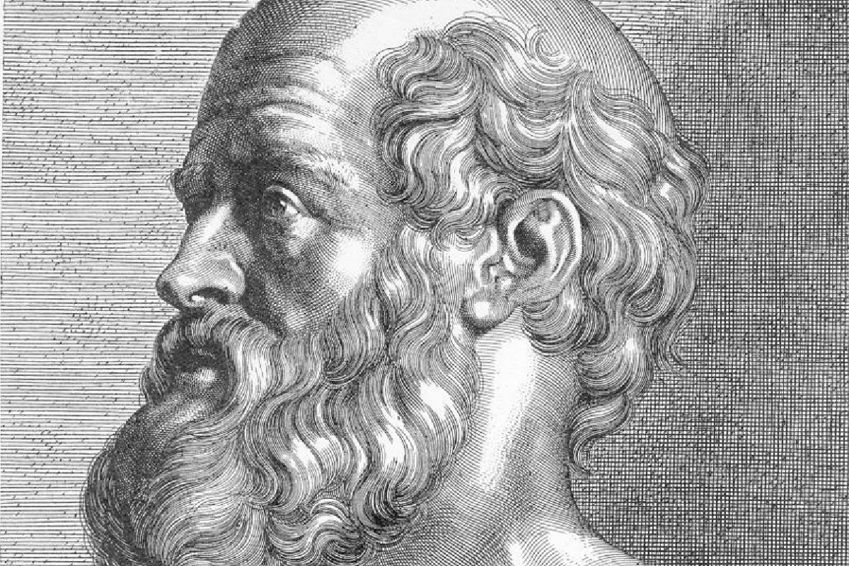
The Prequel:
GFE in Ancient Greece
Hippocrates was unconcerned about his patients’ personal or individual treatment goals.
He was interested in carefully examining, describing, categorizing, diagnosing, and treating the person’s dysfunction and symptomology.
(c.f., Garrison, 1960; Martí-Ibáñez, 1961; Nuland, 1988)

Slide 9
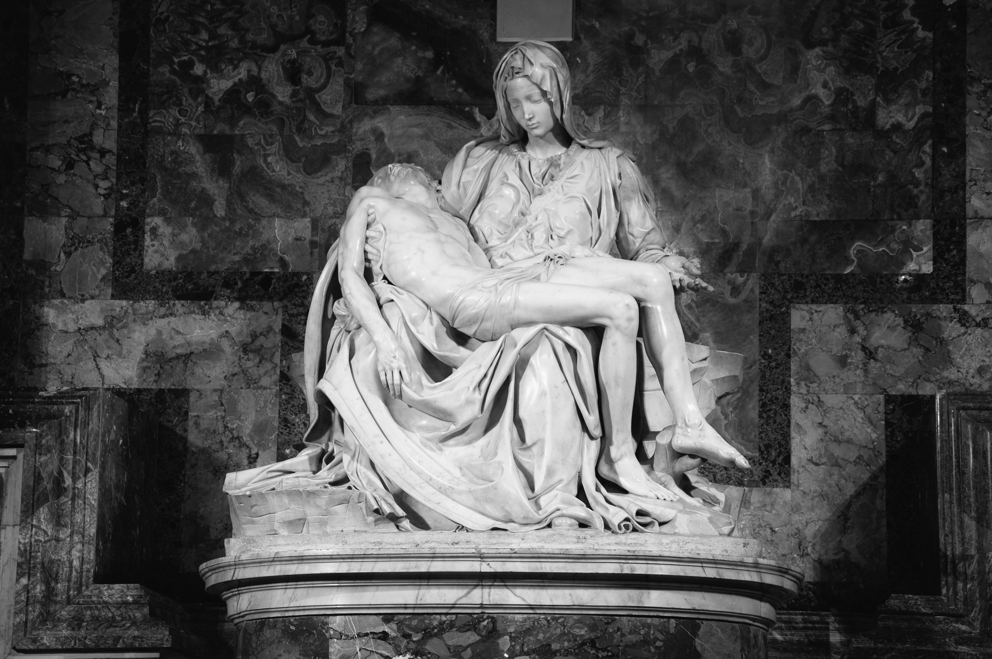
The Prequel:
GFE in Renaissance Art Criticism
In The Lives of the Artists (1550-68), Vasari writes:
“These things, I say, Raphael considered, and not being able to approach Michelangelo in that part of the nude, he resolved in these other parts to emulate and perhaps surpass him.”
“Pietà” Sculpture by Michelangelo (1498-1499)
(Vasari cited in Venturi, 1934/1964, p. 103)

Slide 10
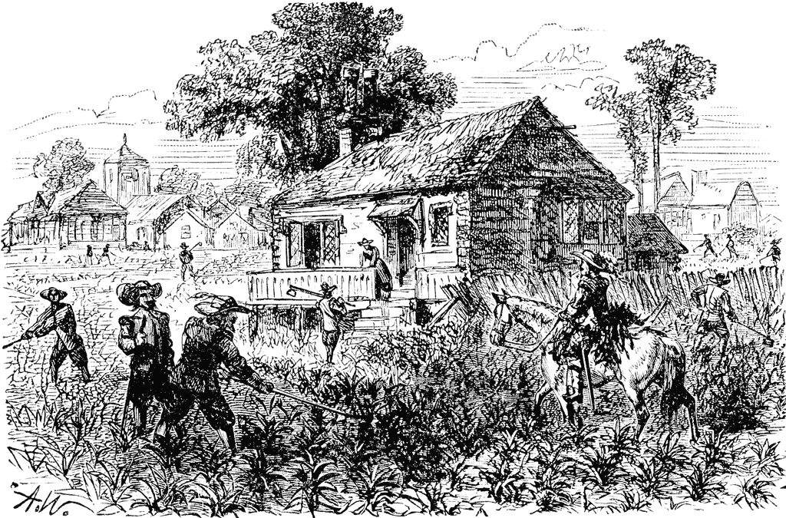
The Prequel:
GFE in Colonial American Education
In Colonial American, the local government or clergy created supervisory committees tasked with evaluating teachers and the quality of school instruction.
There was substantial uncertainty and variation in the evaluation agenda, the criteria used to judge the teachers and/or school, and the methods used to do so.
(Tracy, 1995)
(Marzano et al., 2011)

Slide 11
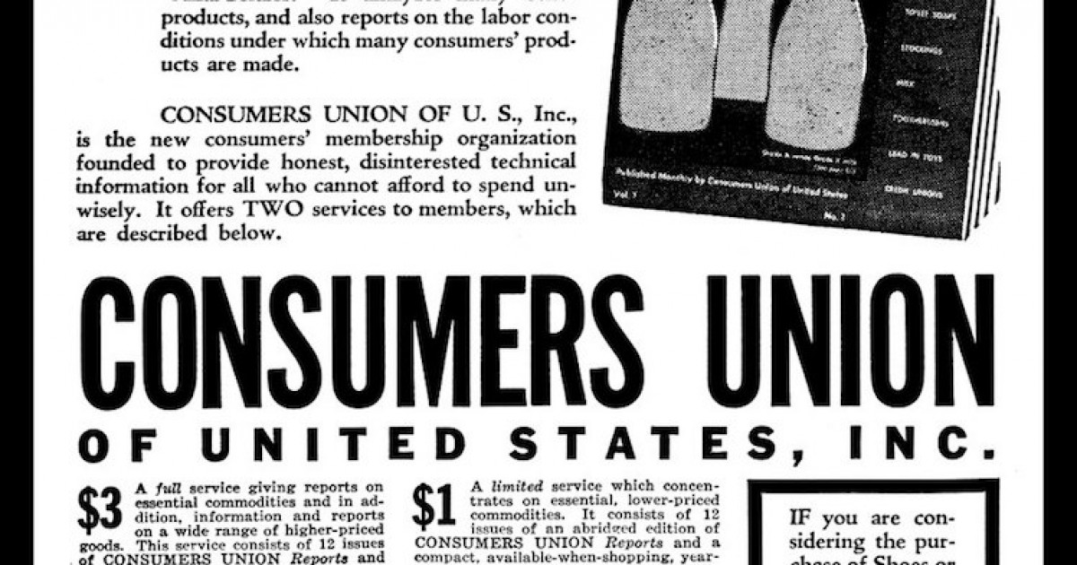
The Prequel:
GFE in Product Evaluation
The Consumers Union’s evaluations exemplify GFE with a long history of combining quantitative data collection methods with a goal-free approach.
(Scriven, 1991)

Slide 12
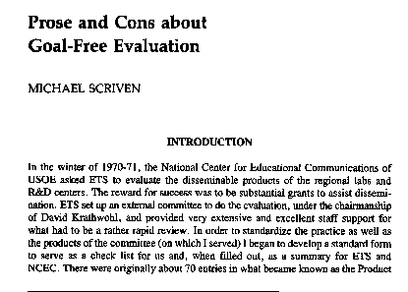
Episode 2: Goal-Free Evaluation
The Discovery of GFE
“The Prose and Cons about Goal-Free Evaluation”

Slide 13
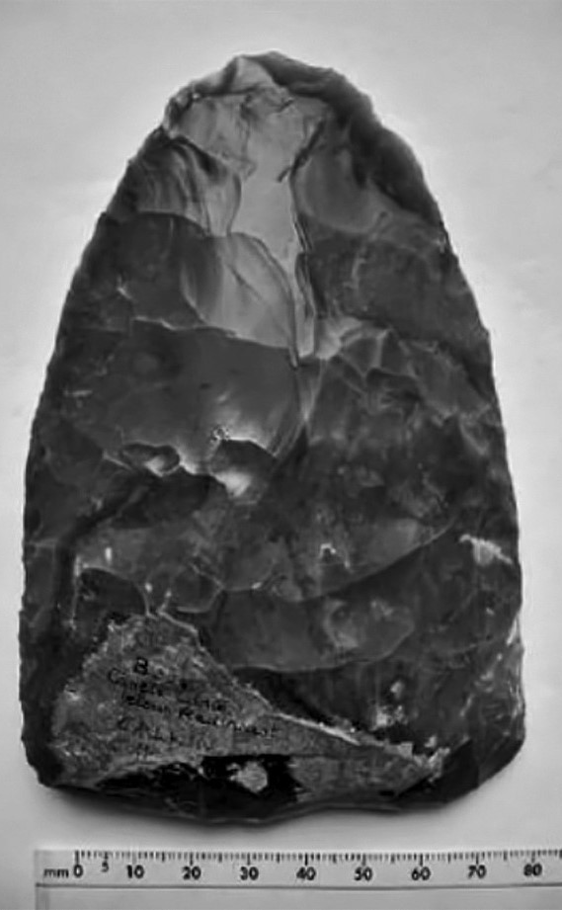

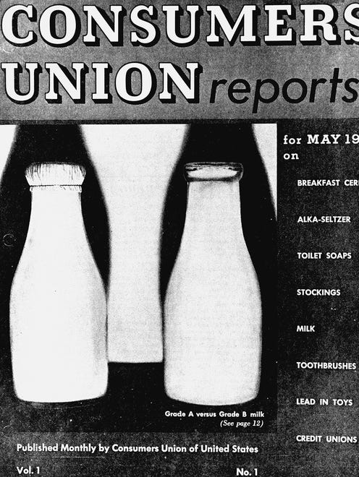
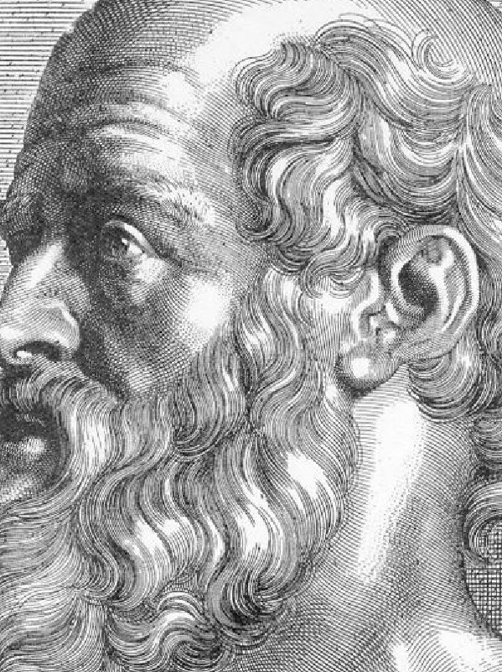
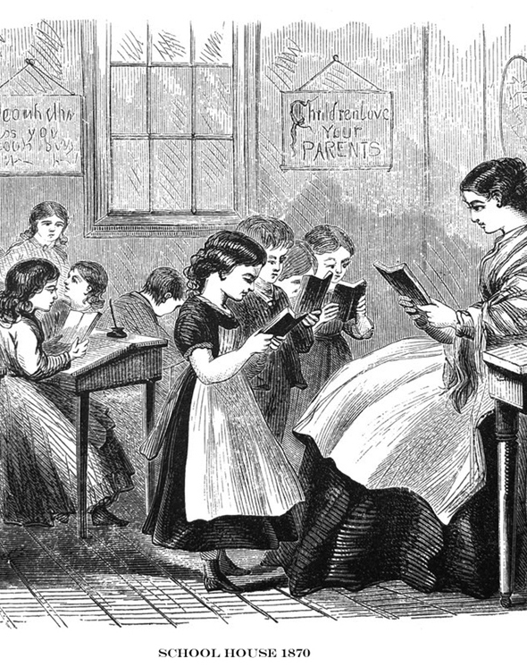
Goal-Free Evaluation
IN HISTORY
Trade & Agriculture
Renaissance
Art criticism
Product Evaluation
Contemporary GFE
Prehistory
1550
Colonial American Education
1936
1972+
Ancient Greek Medicine
GFE’s Discovery
Prehistoric people used a goal-free approach in toolmaking & agriculture.
C. 400 BCE
Giorgio Vasari used a goal-free approach in art criticism.
1700s
Consumers Union founded & uses goal-free product evaluations.
1972
Scores of scholars and practitioners use GFE.
Hippocrates of Cos used a goal-free approach in medicine.
Supervisory committees used a goal-free approach in teacher & school evaluation.
Michael Scriven publishes “Prose and Cons about Goal-Free Evaluation.”

Slide 14
Episode 3: Post-Discovery of GFE
Example of GFEs Conducted Around the U.S.
State or Region | Initiative Type | Authors
Illinois | National school curriculum | House (1974)
Minnesota | Occupational therapy education | Welch (1978)
New Jersey | Drug prevention program | Bry (1979)
Indiana | Media | Thiagarajan (1975)
Hawaii | Self-help housing project | Matsunaga & Enos (1997) Stufflebeam et al. 2002)
New England | Family daycare training | Manfredi (2003)
Louisiana & Texas | Hurricane disaster relief | Belanger (2006)
Michigan | Welfare-to-work program | Berkshire et al. (2009)
Kentucky | U.S. history instruction | Mueller & Colley (2015)

Slide 15
Episode 3: Post-Discovery of GFE
Example of GFEs Conducted Around the World
Country or Region | Initiative Type | Authors
United Kingdom | Innovation training | James & Roffe (2000)
Bangladesh | Social development | Dart & Davies (2003)
Sweden | Information systems | Cronholm & Goldkuhl (2003)
Denmark | Corporate knowledge transfer | Hellström & Jacob (2003)
Ghana | Rural development | Dietz et al. (2013)
Bosnia | Solid waste management | World Bank (2014)
Rep. of Georgia | Curriculum development | Pipia (2014)
Democratic Rep. of Congo | Peacebuilding | Brusset et al. (2016)
England | National youth forum | Whiting & Roberts (2016)
Malawi & Ethiopia | Food and income security | Copestake et al. (2018)
Indonesia | Character education | Zurqoni et al. (2018)
Indonesia | Beauty training | Martalena et al. (2019)

Slide 16
Episode 3: Post-Discovery of GFE
Example of GFEs in Evaluation Textbooks
Textbooks & Reference Books | Authors
Program Evaluation | Worthen (1990)
Evaluation Thesaurus | Scriven (1991)
Foundations of Program Evaluation | Shadish et al. (1991)
Utilization-Focused Evaluation | Patton (1997)
International Handbook of Educational Evaluation | Kellaghan & Stufflebeam (2003)
Evaluation Roots | Alkin (2004, 2023)
Evaluation Methodology Basics | Davidson (2005)
Encyclopedia of Evaluation | Mathison (2005)
Program Evaluation Theory & Practice | Mertens and Wilson (2012)
Evaluation Theory, Models, & Applications | Stufflebeam and Coryn (2014)
The Sage Encyclopedia of Educational Research, Measurement, and Evaluation | Frey (2018)

Slide 17
Episode 3: Post-Discovery of GFE
Less Recognized GFE Approaches
  The evaluator doesn’t have access to the goals and objectives.
  Examples:
  Some informal evaluations throughout prehistory
  Kalamazoo Promise scholarship (anonymous donors)
Default GFE
  The evaluator disregards or ignores the goals and objectives.
  Examples:
  Most Significant Change
  Qualitative Impact Protocol
Goal-Dismissive GFE

Slide 18
Episode 3: Post-Discovery of GFE
When Evaluators Use GFE
As external, ex-post facto, participatory, outcome evaluations
For formative, summative, & metaevaluation purposes
To investigate a broad range of outcomes
To determine outcome attribution
To supplement GBE

Slide 19
Episode 3: Post-Discovery of GFE
Common GFE Data Collection Methods
Key informant interviews
Direct observation
Document/archival analysis
Survey questionnaires
Case studies
Checklist approach

Slide 20
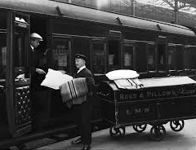
Thank You!
“GFE rocks the train of goal-determined evaluation, which has lulled us to sleep.”
(House, 1974, p. 5)

Slide 21
Some of My Writings on GFE
Youker, B. W. (2013). Goal-free evaluation: A potential model for the evaluation of social work programs. Social Work Research, 37(4), 432-438. https://doi.org/10.56645/jmde.v15i33.444
Youker, B. W., Zielinski, A., Hunter, O. C., & Bayer, N. (2016). Who needs goals? A case study of goal- free evaluation. Journal of Multidisciplinary Evaluation, 12(27), 27–43. https://doi.org/10.56645/jmde. v12i27.448
Youker, B. W., Ford, K., & Bayer, N. (2017). Dismissing the goals: A comparison of four goal-dismissive goal-free evaluations. Evaluation and Program Planning, 46, 1-6.
Youker, B. W. (2018). Goal-free evaluation. In Bruce Frey (Ed.), The Sage encyclopedia of educational research, measurement, and evaluation (pp. 736–739). Sage.
Youker, B. W. (2019). What, how, and why? A comparative analysis of 12 goal-free evaluations. Journal of Multidisciplinary Evaluation, 15(33), 16–29.
Youker, B. W., & Ballard, A. (2024). Goal-free evaluation: An orientation for foundations’ evaluations – Updated 2024. The Foundation Review, 16(1). (Original work published 2014.) https://doi.org/10.9707/1944-5660.1697
Youker, B. W. (2024). Scriven's goal-free evaluation. Journal of Multidisciplinary Evaluation, 20 (47).

